Slide 1
Cyclistic bike-share Analysis
Case Study
By Dawn Yap Shi Min
Last updated: 17 July 2024

Slide 2
Content Page
2
Business task
Introduction
Data sources
1
3
Understanding more about the case study
Citing data sources
Problem to solve
Data cleaning
Top 3
recommendations
Visualisations & analysis
6
4
Creating cleaned data before analysis
Solutions & recommendations
Visualising the data graphically
5

Slide 3
1.
Introduction

Slide 4
Introduction to the (fictional) company:
Cyclistic
Cyclistic marketing strategy:
Focussed on increasing awareness & appealing to broad consumer segments
Flexible pricing plans:
Member: annual memberships
Casual: single-ride or full day passes
Financial analysis:
To maximise profits & ensure growth
Cyclistic should focus on conversion of casual users to members

Slide 5
Introduction to the case-study
Cyclistic – bike-sharing
Cyclistic:
Bike-share program with more than 5800 bicycles & 600 docking stations
Inclusive to all types of users by offering wide range of bicycles
Current user dynamics:
30% of users: for commuting to work
70% of users: for leisure
Key stakeholders
Lily Moreno: marketing director; in charge of promoting the bike-share program
Cyclistic marketing analytics team
Cyclistic executive team

Slide 6
Cyclistic marketing goals:
Business task
Target audience:
Casual riders: full-day pass & single-ride passes
Goal:
To increase conversion of casual riders to annual members
How do annual members and casual riders use Cyclistic bikes differently?

Slide 7
2.
Data Sources

Slide 8
Data sources
Public data retrieved from:
https://divvy-tripdata.s3.amazonaws.com/index.html (2023 data)
Data licensed by:
https://divvybikes.com/data-license-agreement

Slide 9
3.
Data Cleaning

Slide 10
Data Cleaning: Columns
To keep
To remove
ride_id
start_lat
rideable_type
start_lng
started_at
end_lat
ended_at
end_lng
start_station_name
start_station_id
end_station_name
end_station_id
member_casual

Slide 11
Data cleaning:
renaming member_casual
Misleading column
Renamed to user_type
Variables:
Member
casual
member_casual
user_type

Slide 12
Data cleaning:
renaming member_casual
Misleading column
Renamed to user_type
Variables:
Member
casual
member_casual
user_type

Slide 13
Data cleaning:
Combining datasets
mar2023
apr2023
feb2023
may2023
jan2023
jun2023
monthly2023
dec2023
nov2023
aug2023
jul2023
oct2023
sep2023

Slide 14
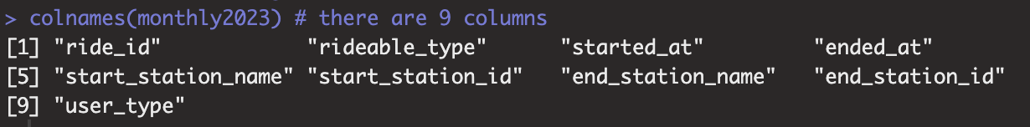
Data cleaning
Understanding the data frames
colnames(): shows that the data frame has 9 columns
str(): shows that the data frame has 5719877 rows

Slide 15
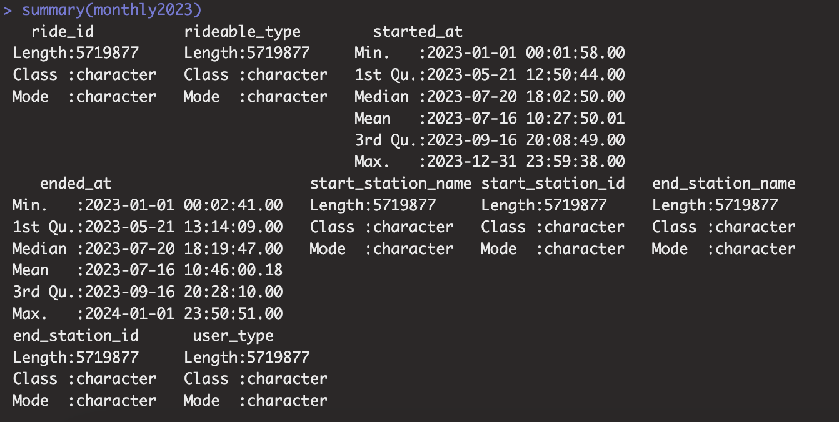
Data cleaning
Understanding the data frames
summary(): shows the summary data for each column

Slide 16
Data cleaning:
Separating date & time into 2 columns
start_date
started_at
start_time
H: M: S
end_date
ended_at
end_time
H: M: S

Slide 17
Data cleaning:
Calculating trip duration
Taking the difference between start & end
Units: minutes
Ensure data type is <numeric>
difftime(ended_at, started_at, units = "mins")

Slide 18
Data cleaning:
Final cleaning of data
drop_na()
Removing rows with NULL values
distinct()
Removing duplicate rows
> 0
Keeping only rows with trip duration >0

Slide 19
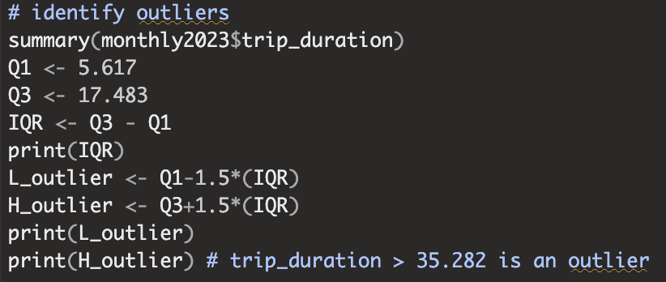
Data cleaning:
Identifying outliers
There are 328300 rows with trip_duration
> 35.282

Slide 20
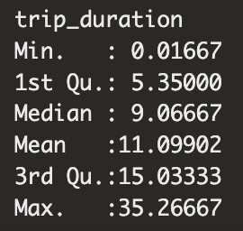
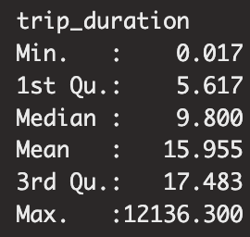
Data cleaning:
Removing outliers
monthly2023_withoutoutliers
monthly2023

Slide 21
5.
Visualisation & Analysis

Slide 22
Visualisation & analysis
Removing outliers
monthly2023_withoutoutliers
monthly2023
Casual
Member
Casual
Member
1531646
2799608
1304410
2698544
Total: 4331254
Total: 4002954

Slide 23
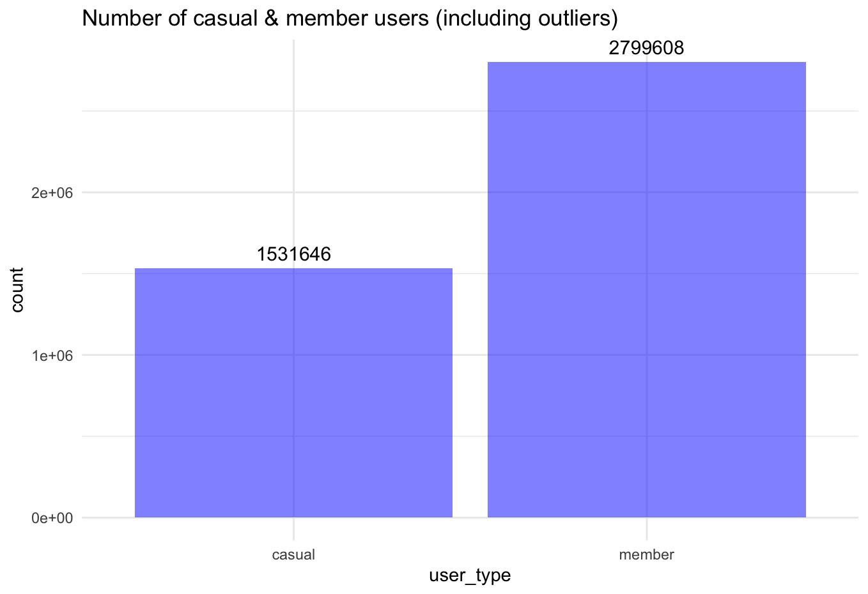
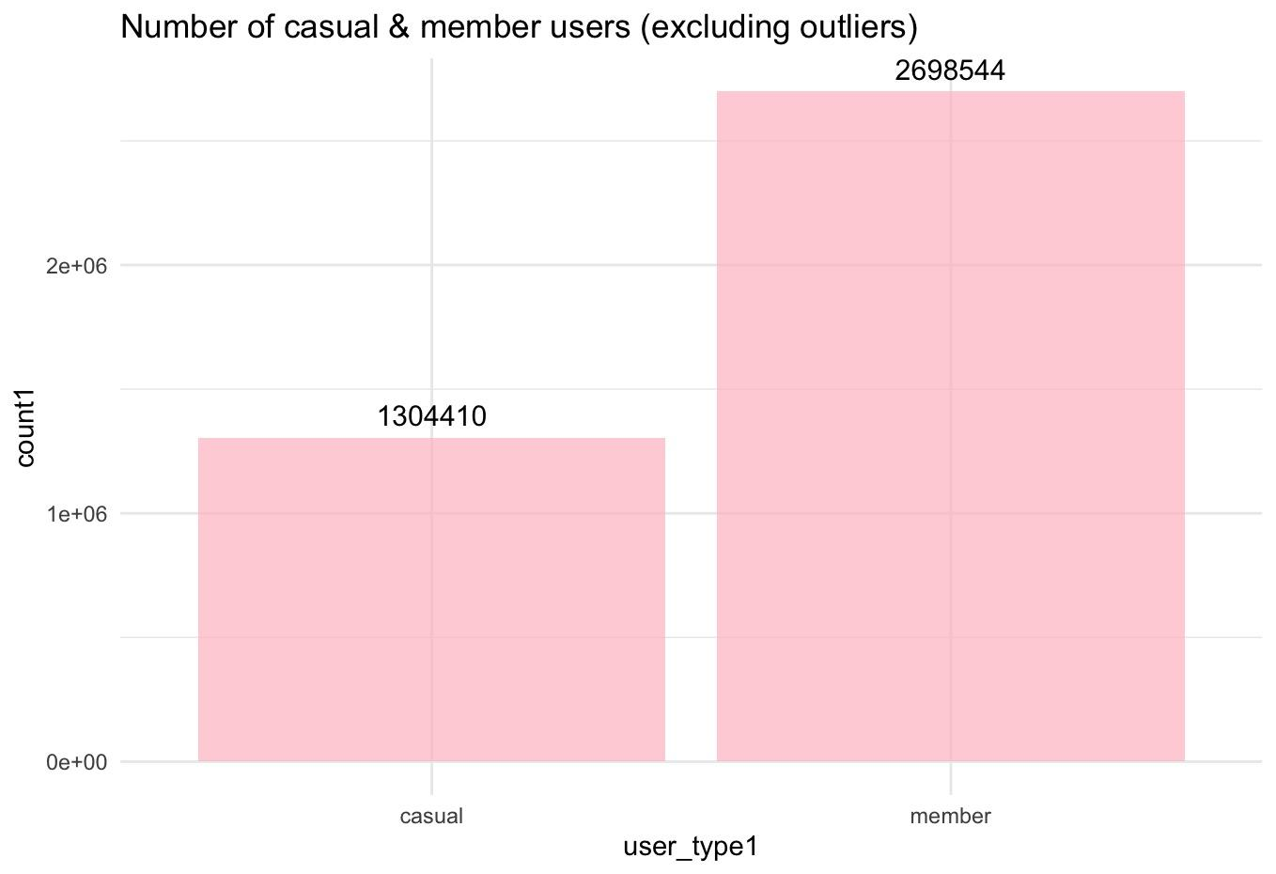
Visualisation & analysis

Slide 24
Visualisation & analysis
Visualisation & analysis
Outliers should not be removed
The majority of the outliers are casual users
Casual users includes day-passes & single-use passes.
Those users may have bought day passes or simply forgot to lock them up
Either way, these data are worth examining

Slide 25
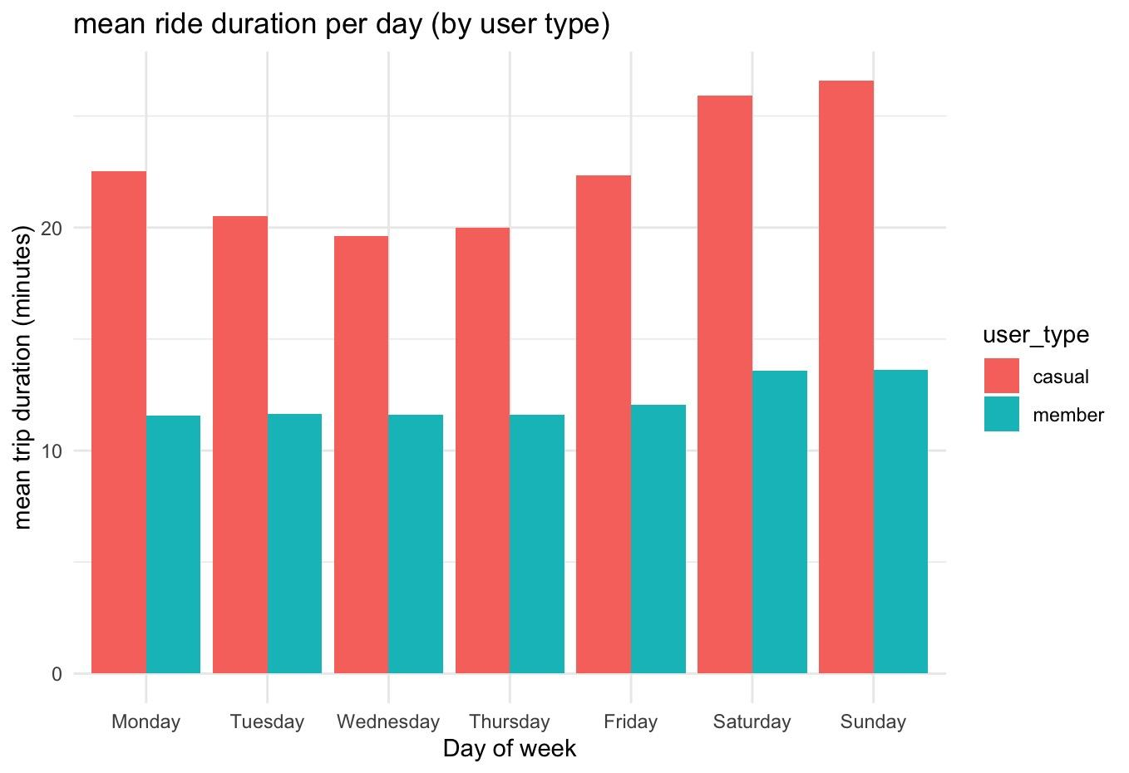
Visualisation & analysis

Slide 26
Visualisation & analysis
Visualisation & analysis
Users by day
There are the most bike users during the weekend, for both types of users
The differences are more apparent for casual-users
This could be due to more casual users riding for leisure purposes
We could tap onto such a trend to cater to their needs by providing weekend-only annual passes

Slide 27
6.
Recommendations

Slide 28
Recommendation 1
Include more flexible annual passes
There are the most bike users during the weekend, for both types of users
The differences are more apparent for casual-users
This could be due to more casual users riding for leisure purposes
We could tap onto such a trend to cater to their needs by providing weekend-only annual passes to fulfil their leisure needs

Slide 29
Recommendation 2
Increase reminders on annual passes
In general, mean trip duration is longer for casual users
Frequent reminders can be made whenever the casual users hit a streak of ≥15 minutes for ≥3 days
A history tab can be included in the app to allow users to track their usage & realise that an annual pass may be a better option for their riding habits

Slide 30
Recommendation 3
Research on the reasons for outliers
The outliers are occurring mostly within casual users
This may indicate a habit/issue within casual users
The long trip duration may be due to negligence or carelessness
This may also be a functional/administrative error
Identifying the reason allows for the marketing team to come up with corresponding measures or for management to correct the error for the future

Slide 31
Thank You!
Connect with me at:
1
LinkedIn
Dawn Yap
2
GitHub
ddxwnny
3
Email
dawnyap2004@gmail.com

